Slide 1

ISE 218: Fundamentals of Information Technology Unit 05 and Unit 06 Review
Spring 2025
Instructor: Abid Malik
co-Instructor: Xinrui Yu

Slide 2
Class Hours for Weeks 15 and 16
Tuesday and Friday (07:00 PM – 09:25 PM) , Lixi 314
No classes during usual class hours

Slide 3
Midterm 05/30
Scope: Units 5 and 6
Time: 120 minutes (during class hours, 7 PM to 9 PM)
Closed-book, Closed-notes, no electronic devices including calculators
25 multiple choices, 10 calculation questions
Practice problems for units 5 and 6 has been provided on Teams
You need to bring 2B pencils

Slide 4
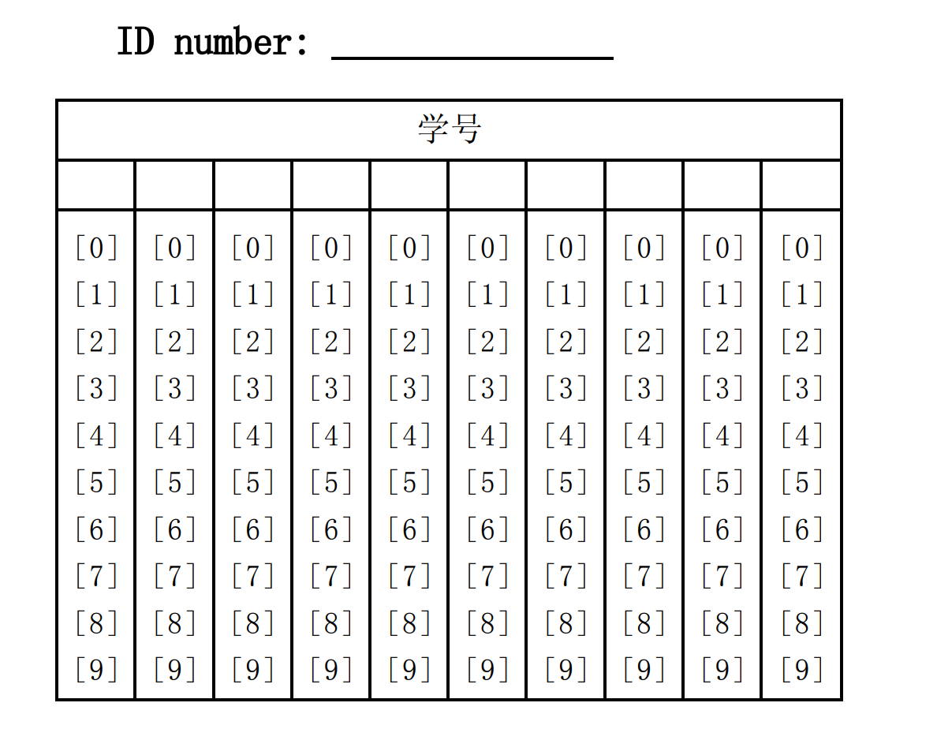
18 for R

Slide 5
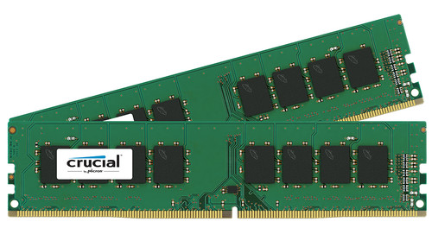
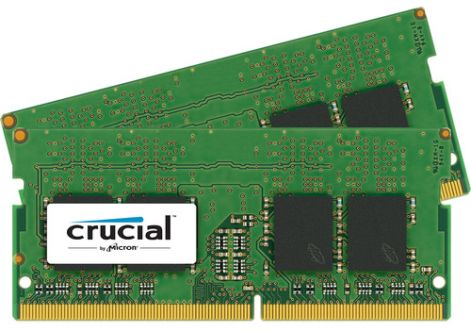
Types of Memory
There are two kinds of main memory: random access memory, RAM, and read-only-memory, ROM.
There are two types of RAM, dynamic RAM (DRAM) and static RAM (SRAM).
DRAM consists of capacitors that slowly leak their charge over time.
Thus, they must be refreshed every few milliseconds to prevent data loss.
DRAM is “cheap” memory, owing to its simple design.
LPDDR4 SDRAM
Low-Power Double Data Rate Synchronous Dynamic
Random-Access Memory

Slide 6
Types of Memory
SRAM is very fast memory and it doesn’t need to be refreshed like DRAM does, but does need a constant supply of power. It is used to build cache memory, which we will explore later.
Briefly, cache memory is very high-speed memory that helps to make modern computers so fast
ROM also does not need to be refreshed, either.
ROM is used to store permanent or semi-permanent data that persists even while the system is turned off.
For example, the program that boots the computer when the computer is turned on is stored in a ROM chip.

Slide 7
Types of Memory – Q1
Which of the following types of memory is typically used for the main memory in computers due to its density and cost-effectiveness? [Multiple Choice]
A. SRAM B. Flash C. DRAM D. EEPROM
C - DRAM.

Slide 8
Types of Memory – Q2
DRAM retains data without the need for refreshing as long as power is supplied. [True/False]
False.
Dynamic – Needs refreshing
Static – Does not need refreshing but need power supply
ROM – Does not need power supply, Read Only
Flash – Non-volatile, in block, used for flash drives and SSDs

Slide 9
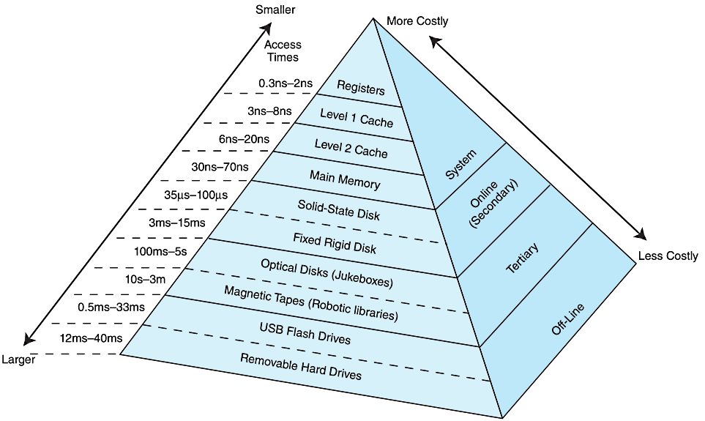
The Memory Hierarchy
Notes:
"TER-she-err-ee.“
Online: working memory
Offline: Removable memory

Slide 10

The Memory Hierarchy
In enterprise systems (e.g., the software that runs large corporations), backups are held in tertiary storage
These backup systems can consist of many tapes and optical disks that are retrieved using robotic systems
archive.boston.com/bigpicture/2009/11/large_hadron_collider_ready_to.html

Slide 11
The Memory Hierarchy
While a computer is running, for the CPU to access a particular piece of data, it first sends a request to its nearest memory, usually cache.
If the data is not in cache, then main memory is checked. If the data is not in main memory, then the request goes to disk.
Disk is a form of secondary storage
Once the data is located, then the data, and a number of its nearby data elements are fetched into cache memory.
This leads us to some definitions:
A hit is when data is found at a given memory level.
A miss is when it is not found.
The hit rate is the percentage of time data is found at a given memory level.
The miss rate is the percentage of time it is not. (miss rate = 1 – hit rate.)
Notes:
命中、丢失（未命中）

Slide 12
The Memory Hierarchy
Some additional definitions:
The hit time is the time required to access data at a given memory level.
The miss penalty is the time required to process a miss, including the time that it takes to replace a block of memory plus the time it takes to deliver the data to the processor.
We want the hit rate to be as high as possible and the hit time (and miss penalty) to be as low as possible
Notes:
命中时间、丢失惩罚

Slide 13
Data Storage – Q1
Which of the following is most appropriate for long-term storage of infrequently accessed data? [Multiple Choice]
SSD B. Optical Disk C. DRAM D. Register Memory
B – The best option among the four.

Slide 14
Cache Memory
The purpose of cache memory is to speed up accesses by storing recently used data closer to the CPU.
Although cache is much smaller than main memory, its access time is a fraction of that of main memory.

Slide 15
Virtual Memory
Cache memory enhances performance by providing faster memory access speed.
Virtual memory enhances performance by providing greater memory capacity, without the expense of adding main memory.
Instead, a portion of a disk drive serves as an extension of main memory.

Slide 16
Cache Memory
When the CPU generates a memory address, cache is checked first to see if the data value is available there
If the value is not in the cache, then the block of memory containing that value is copied into a block of cache (the memory/cache block sizes are equal)
The address of the data in memory is generally not the address of the data in the cache
The main memory address must be mapped to an address in the cache
There are several ways of performing this mapping, but we will look at only two

Slide 17
Cache Memory: Direct Mapped Cache
The simplest cache mapping scheme is direct mapped cache.
In a direct mapped cache consisting of N blocks of cache, block X of main memory maps to cache block Y = X mod N.
mod stands for modulo or modulus
The notation X mod N means “give me the remainder of X divided by N”.
Thus, if we have 10 blocks of cache, block 7 of cache could hold blocks 7, 17, 27, 37, ... of main memory.
With direct mapped cache consisting of N blocks of cache, block X of main memory maps to cache block Y = X mod N.

Slide 18
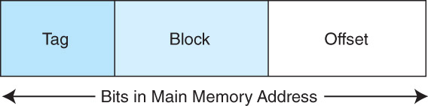
Direct Mapped Cache
To perform direct mapping, a binary main memory address is partitioned into the fields shown below.
The offset field uniquely identifies an address within a specific block.
The block field selects a unique block of cache.
The tag field is whatever is leftover.
The sizes of these fields are determined by characteristics of both memory and cache.

Slide 19
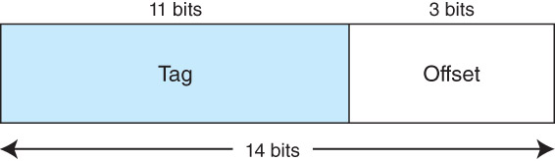
Associative Cache
Suppose instead of placing memory blocks in specific cache locations based on memory address, we could allow a block to go anywhere in cache.
In this way, cache would have to fill up before any blocks are evicted.
This is how fully associative cache works.
A memory address is partitioned into only two fields: the tag and the offset.
Suppose we have 14-bit memory addresses (with byte-addressable memory) and a cache with 16 blocks where each block has 8 bytes. The field format of a memory reference is:
When the cache is searched, all tags are searched in parallel to retrieve the data quickly. This requires special, costly hardware.
Notes:
全相连缓存
matching by tag (content), not by fixed location.

Slide 20
Direct Mapped Cache: Homework 5 Q5
Assume a byte-addressable memory consists of 2²⁰ bytes, cache has 32 blocks, and each block has 8 bytes.
The number of memory blocks is: 2²⁰/2³ = 2¹⁷ = 65536 * 2
Each main memory address requires 20 bits. Of this 14-bit address field, the rightmost 3 bits reflect the offset field (why? because 2³ = 8)
Need 5 bits to select a specific block in cache (why? because 2⁵ = 32), so the block field consists of the middle 5 bits.
The remaining 12 bits make up the tag field.

Slide 21
Direct Mapped Cache: Homework 5 Q5 Extra
Assume a byte-addressable memory consists of 2²⁰ bytes, cache has 32 blocks, and each block has 8 bytes.
Now we know 12 bits for tag, 5 bits for block number, and 3 bits for offset.
What is the tag number, block number, and offset for the byte stored in address 0x47285? Show in decimal.
Hex to binary: 0100 0111 0010 1000 0101 tag block offset
Tag: 2^10 + 2^6 + 2^5 + 2^4 + 2^1 = 1024 + 64 + 32 + 16 + 2 = 1138
Block: 2^4 = 16
Offset: 5

Slide 22
Fully Associative Cache: Homework 5 Q4
Assume a byte-addressable memory consists of 2²⁰ bytes, cache has 16 blocks, and each block has 8 bytes.
The number of memory blocks is: 2²⁰/2³ = 2¹⁷ = 65536 * 2
Each main memory address requires 20 bits. Of this 14-bit address field, the rightmost 3 bits reflect the offset field (why? because 2³ = 8)
No block field for fully associative cache.
The remaining 17 bits make up the tag field.

Slide 23
Block Replacement Policy
Direct mapped cache evicts a block whenever another memory reference needs that block.
With fully associative cache, we have no such mapping
We need an algorithm to determine which block to evict from the cache.
The block that is evicted is the victim block. But how do we pick a victim?
With fully associative cache, a replacement policy is invoked when it becomes necessary to evict a block from cache.

Slide 24
Block Replacement Policy
The replacement policy that we choose depends upon the locality that we are trying to optimize – usually, we are interested in temporal locality.
A least recently used (LRU) algorithm tracks when a block was last accessed and evicts the block that has been unused for the longest period of time.
To implement LRU we need to keep track of the “age” of the block in the cache
First-in, first-out (FIFO) is a different popular cache replacement policy.
In FIFO, the block that has been in the cache the longest, regardless of when it was last used. A special kind of list called a queue is used to track this information.
Notes:
字面：最近使用的最少
移除最长时间未使用的

Slide 25
LRU Block Replacement: Homework 5 Q1
Suppose a program makes a sequence of memory references that cause the following memory blocks to be read, in this order: D, A, E, A, C, G, E, F.
The CPU’s cache has 4 blocks
Show the state of the cache after each memory block access
Indicate the age of a block by giving the sequence number of when the block was last referenced

Slide 26
LRU Block Replacement: Homework 5 Q1
Block access sequence: D, A, E, A, C, G, E, F.
Block access sequence: D, A, E, A, C, G, E, F.
Block access sequence: D, A, E, A, C, G, E, F.
Block access sequence: D, A, E, A, C, G, E, F.
D (1)
D (1) | A (2)
D (1) | A (2) | E (3)
D (1) | A (4) | E (3)

Slide 27
LRU Block Replacement: Homework 5 Q1
Block access sequence: D, A, E, A, C, G, E, F.
Block access sequence: D, A, E, A, C, G, E, F.
Block access sequence: D, A, E, A, C, G, E, F.
Block access sequence: D, A, E, A, C, G, E, F.
D (1) | A (4) | E (3) | C (5)
G (6) | A (4) | E (3) | C (5)
G (6) | A (4) | E (7) | C (5)
G (6) | F (8) | E (7) | C (5)

Slide 28
FIFO Block Replacement: Homework 5 Q2
Suppose a program makes a sequence of memory references that cause the following memory blocks to be read: A, B, D, E, A, D, A, C, B, F, A
The CPU’s cache has 4 blocks and uses FIFO as the replacement policy
Show the state of the cache after each memory block access
Assume the left-hand side of the queue is the head of the queue. Use an arrow to mark the oldest block in the queue.
Empty queue:

Slide 29
FIFO Block Replacement: Homework 5 Q2
Block access sequence: A, B, D, E, A, D, A, C, B, F, A
Block access sequence: A, B, D, E, A, D, A, C, B, F, A
Block access sequence: A, B, D, E, A, D, A, C, B, F, A
A
A | B
A | B | D

Slide 30
FIFO Block Replacement: Homework 5 Q2
Block access sequence: A, B, D, E, A, D, A, C, B, F, A
Block access sequence: A, B, D, E, A, D, A, C, B, F, A
Block access sequence: A, B, D, E, A, D, A, C, B, F, A
A | B | D | E
A | B | D | E
A | B | D | E

Slide 31
FIFO Block Replacement: Homework 5 Q2
Block access sequence: A, B, D, E, A, D, A, C, B, F, A
Block access sequence: A, B, D, E, A, D, A, C, B, F, A
Block access sequence: A, B, D, E, A, D, A, C, B, F, A
A | B | D | E
C | B | D | E
C | B | D | E

Slide 32
FIFO Block Replacement: Homework 5 Q2
Block access sequence: A, B, D, E, A, D, A, C, B, F, A
Block access sequence: A, B, D, E, A, D, A, C, B, F, A
C | F | D | E
C | F | A | E

Slide 33
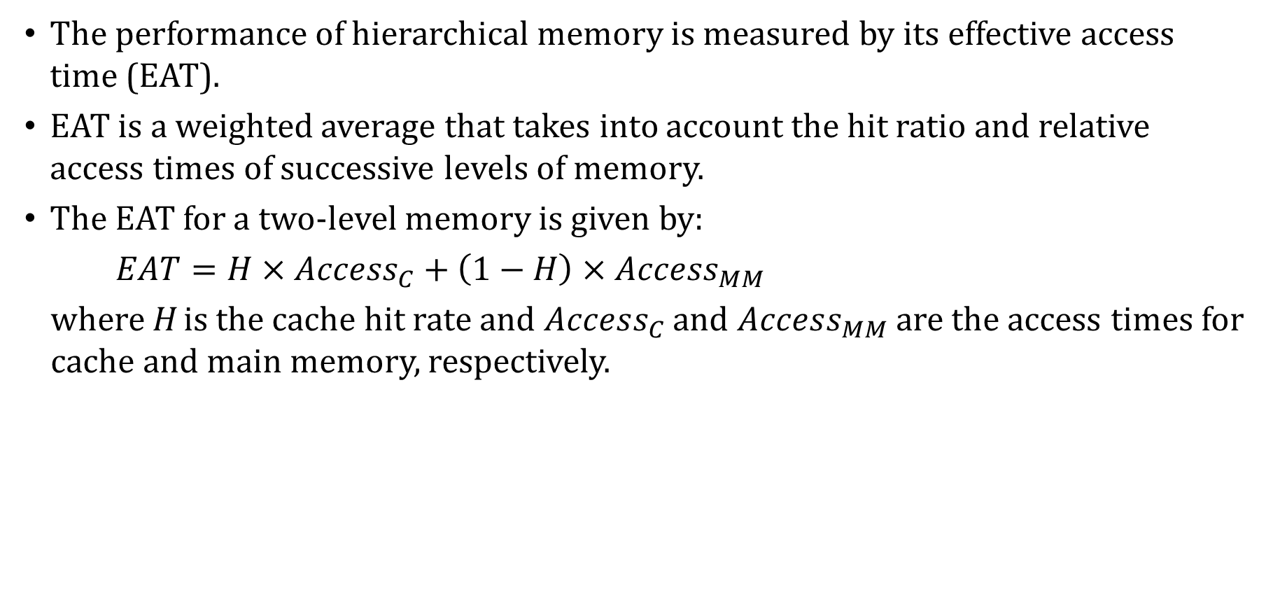
Cache Memory: Effective Access Time
The performance of hierarchical memory is measured by its effective access time (EAT).
EAT is a weighted average that takes into account the hit ratio and relative access times of successive levels of memory.
The EAT for a two-level memory is given by:
$EAT=H×Access_{C}+\left(1−H\right)×Access_{MM}$
where H is the cache hit rate and $Access_{C}$ and $Access_{MM}$ are the access times for cache and main memory, respectively.
Notes:
有效访问时间?
等效访问时间

Slide 34
Effective Access Time: Example #1
For example, consider a system with a main memory access time of 200ns supported by a cache having a 10ns access time and a hit rate of 99%.
Suppose access to cache and main memory occurs concurrently, as opposed to sequentially.
In this scenario, the CPU initiates requests to cache and main memory simultaneously.
That is, the two requests overlap, so that if the block is not in cache, the request to main memory is already on its way.
The EAT is 0.99(10ns) + 0.01(200ns) = 9.9ns + 2ns = 11.9ns.
Notes:
tst

Slide 35
Effective Access Time: Example #2
If the accesses do not overlap, they must instead happen sequentially
In this scenario, the CPU first checks the cache for the block. If the block is not in the cache, the CPU initiates a request to main memory.
The EAT is 0.99(10ns) + 0.01(10ns + 200ns) = 9.9ns + 2.1ns = 12ns.

Slide 36
I/O Architectures
We define input/output as a subsystem of components that moves coded data between external devices and a host system.
I/O subsystems include:
Blocks of main memory that are devoted to I/O functions.
Buses that move data into and out of the system.
Control modules in the host and in peripheral devices
Interfaces to external components such as keyboards and disks.
Cabling or communications links between the host system and its peripherals.

Slide 37
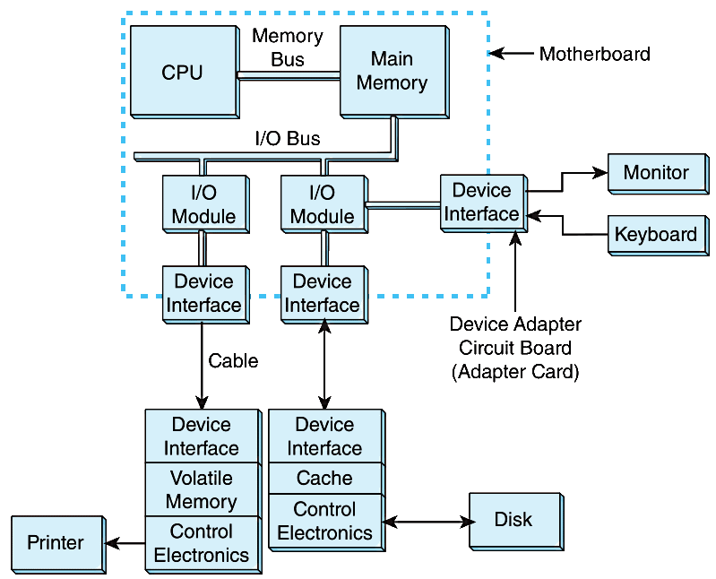
I/O Architectures
This figure shows an integrated I/O subsystem
Slower I/O devices like printers need to buffer the data sent to them by the CPU

Slide 38
I/O Architectures
Communication between devices is defined by a set of rules called a protocol
As an example, one rule might be that the receiver acknowledge commands and data sent to it
“I am ready for your data!”
“I received your data!”
This type of protocol, when the two parties establish the communication parameters before communicating, is called a handshake protocol

Slide 39
I/O Architectures
I/O can be controlled in five general ways:
Programmed I/O reserves a register for each I/O device. Each register is continually polled by the CPU to detect data arrival.
Interrupt-Driven I/O allows the CPU to do other things until I/O is requested.
Memory-Mapped I/O shares memory address space between I/O devices and program memory.
Direct Memory Access (DMA) offloads I/O processing to a special-purpose chip that takes care of the details.
Channel I/O uses dedicated I/O processors.

Slide 40
I/O Architectures – Q1
Which of these mechanisms is used to temporarily store data to balance the speed between a slow I/O device and a fast CPU? [Multiple Choice]
A. DMA B. Registers C. Buffers D. ALU
C - Buffers.

Slide 41
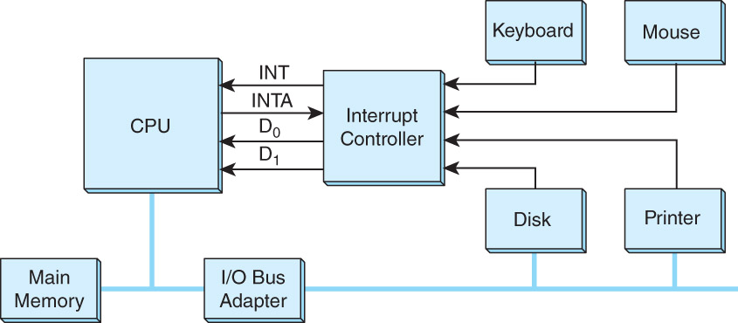
Interrupt-driven I/O
Below is an idealized I/O subsystem that uses interrupts.
Each device connects its interrupt line to the interrupt controller.

Slide 42
Interrupt-driven I/O
The controller signals the CPU on the Interrupt (INT) line when any of the interrupt lines are asserted.
The CPU asserts the Interrupt Acknowledge (INTA) signal to tell the interrupt controller that it got the message and will start processing the interrupt.

Slide 43
Interrupt-driven I/O
Recall that in a system that uses interrupts, the status of the interrupt signal is checked at the start of the fetch-decode-execute cycle.
The particular code that is executed whenever an interrupt occurs is determined by a set of addresses called interrupt vectors that are stored in main memory.
An interrupt vector points to the device driver code that processes the interrupt.
The system state is saved before the interrupt service routine is executed and is restored afterward. Flowchart on the next slide.

Slide 44
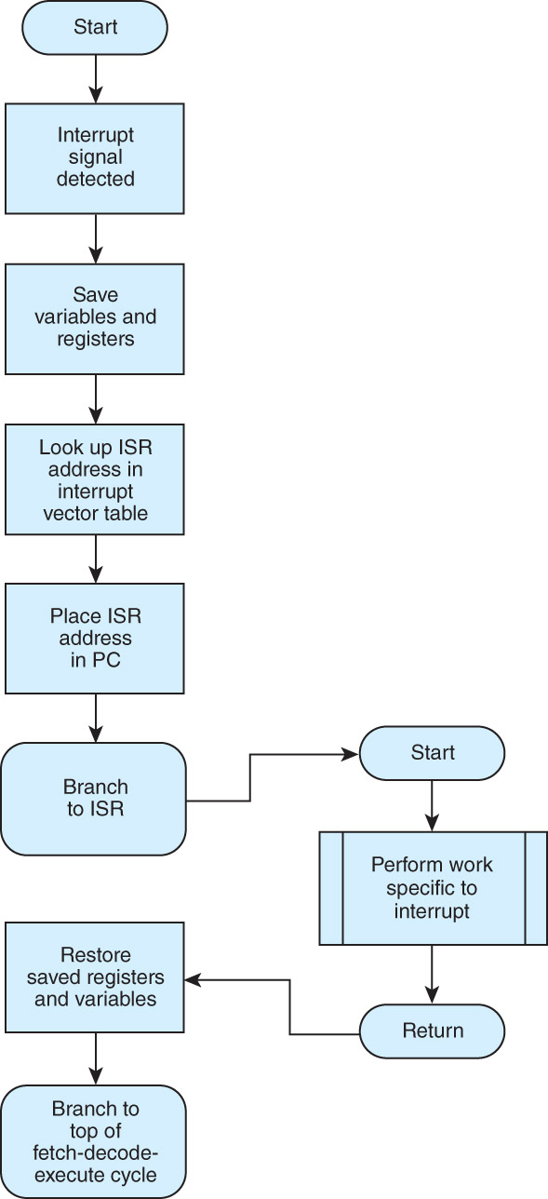
Interrupt-driven I/O

Slide 45
Memory-mapped I/O
In memory-mapped I/O, devices and main memory share the same address space.
Each I/O device has its own reserved block of memory.
Memory-mapped I/O therefore looks just like a memory access from the point of view of the CPU.
Thus the same instructions are used to move data to and from both I/O and memory, greatly simplifying system design.
Each I/O device controller monitors the CPU’s address bus to see if the CPU is accessing a memory address assigned to the device

Slide 46
Direct Memory Access
In DMA, the CPU offloads execution of simple I/O instructions to a dedicated DMA controller
The CPU gives the DMA controller the details of the I/O request (location and number of bytes to transfer, destination device or memory address)
The DMA controller executes the request, writing the data directly to main memory
When the I/O is complete, the DMA sends an interrupt signal to the CPU, so the CPU can process the data
The CPU and DMA controller share the system bus, so when the DMA controller is using the system bus for memory transfers we call it cycle stealing because the CPU can’t use the system bus itself during that time to perform other I/O operations or access main memory

Slide 47
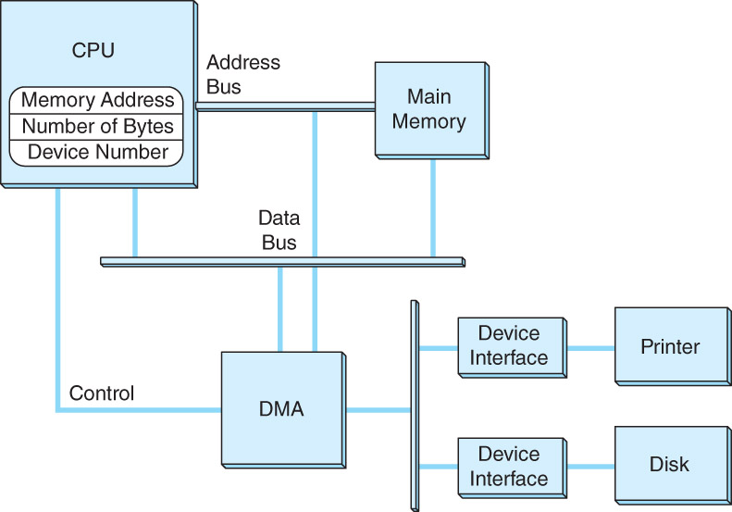
Direct Memory Access
This is a DMA configuration. Notice that the DMA controller and the CPU share the data bus.
The DMA runs at a higher priority and steals memory cycles from the CPU.

Slide 48
Channel I/O
Very large systems employ channel I/O, which is a form of DMA used on mainframe computers and file servers.
Channel I/O consists of one or more I/O processors (IOPs) that control various channel paths.
Slower devices such as terminals and printers are combined (multiplexed) into a single faster channel.
Channel I/O is distinguished from DMA by the “intelligence” of the IOPs.
The IOP negotiates protocols, issues device commands, translates storage coding to memory coding (i.e., data formats), and can transfer entire files independent of the host CPU.
The host has only to create the program instructions for the I/O operation and tell the IOP where to find them.

Slide 49
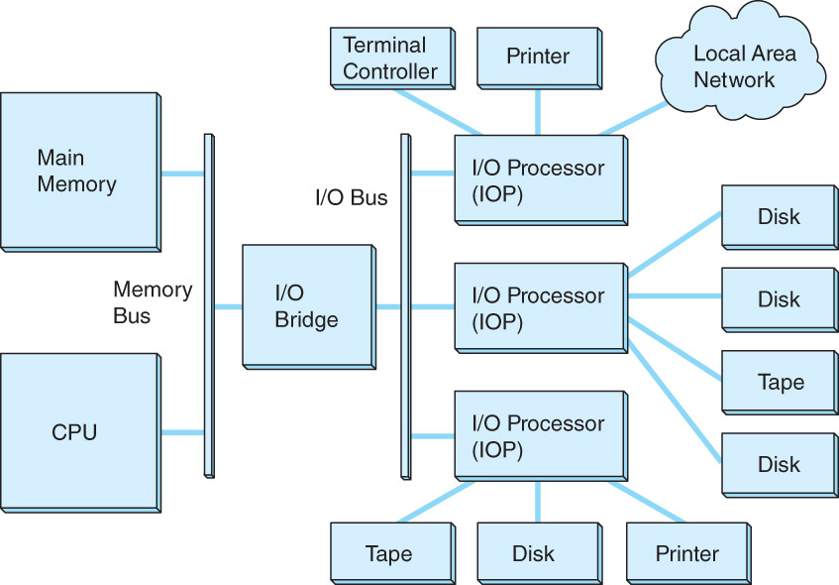
Channel I/O
Like DMA, channel I/O uses cycle stealing, but unlike DMA, uses the system bus only to fetch its instructions from the main memory.
A dedicated I/O bus is used to transfer the actual data between I/O devices (e.g., disk → tape).

Slide 50
Character I/O vs. Block I/O
Character I/O devices process one byte (or character) at a time.
Examples include modems, keyboards, and mice.
Keyboards are usually connected through an interrupt-driven I/O system.
Block I/O devices handle bytes in groups.
Most mass storage devices (disk and tape) are block I/O devices.
Block I/O systems are most efficiently connected through DMA or channel I/O, which handle large data transfers efficiently.

Slide 51
I/O Architectures – Q1
Which I/O method is most likely to cause the CPU to check the status of a device repeatedly in a loop? [Multiple Choice]
DMA B. Programmed I/O C. Interrupt-driven I/O D. Channel I/O
B – Polling takes CPU time.

Slide 52
I/O Architectures – Q2
What is the main function of a channel controller in a computer system? [Multiple Choice]
A. Handles screen refresh cycles B. Controls the clock rate of the CPU C. Manages complex I/O operations independently D. Maintains cache coherence
C - The IOP negotiates protocols, issues device commands, translates storage coding to memory coding (i.e., data formats), and can transfer entire files independent of the host CPU.

Slide 53
I/O Architectures – Q3
Which of the following is a common use case for DMA in modern systems? [Multiple Choice]
A. Executing conditional branches B. Managing memory segmentation C. Performing large block transfers from disk to RAM D. Updating the program counter
C – DMA is used for data transfer with RAM

Slide 54
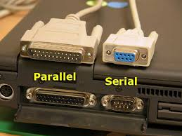
Data Transmission Modes
Bytes can be conveyed from one point to another by sending their encoding signals simultaneously using parallel data transmission or by sending them one bit at a time in serial data transmission.
In parallel data transmission, the interface requires one wire for each bit.
Parallel cables are fatter than serial cables.
Compared with parallel data interfaces, serial communications interfaces:
Require fewer conductors (wires), making them cheaper.
Are less susceptible to attenuation (loss of signal strength), which is caused when multiple wires are adjacent to each other (as in parallel cables).
Can transmit data farther and faster more reliably.
With parallel transmission the multiple bits might not arrive at exactly the same time, further complicating matters

Slide 55
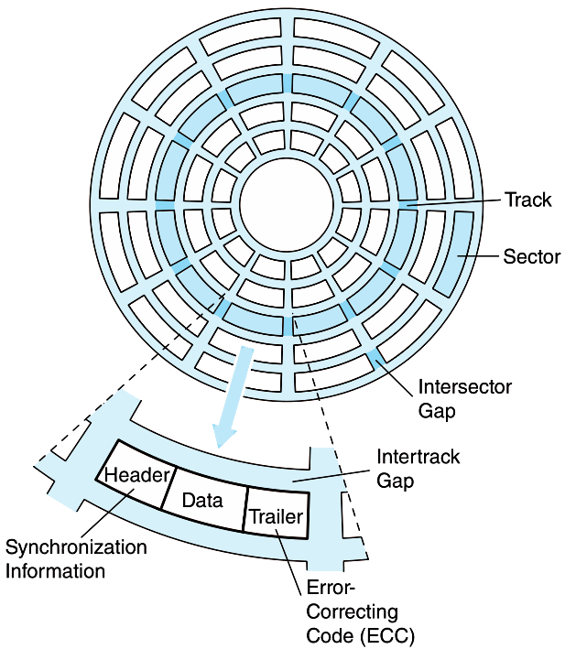
Magnetic Disk Technology
Magnetic disks offer large amounts of durable storage that can be accessed quickly.
Disk drives are called random (or direct) access storage devices, because blocks of data can be accessed according to their location on the disk.
This term was coined when all other durable storage (e.g., tape) was sequentially accessed.
Disk tracks are numbered from the outside edge, starting with zero.

Slide 56
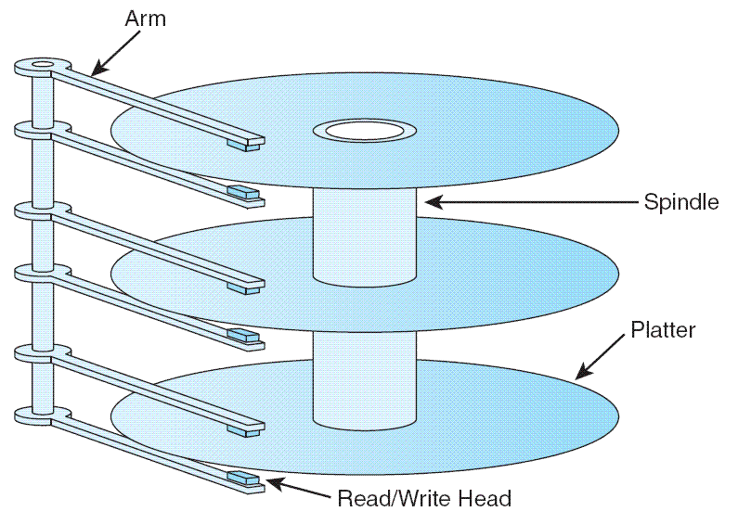
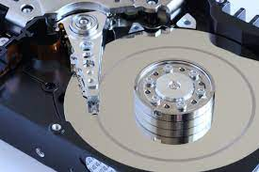
Magnetic Disk Technology
Hard disk platters are mounted on spindles.
Read/write heads are mounted on a comb that swings radially to read the disk.
The rotating disk forms a logical cylinder beneath the read/write heads.
Data blocks are addressed by their cylinder, surface, and sector.
Head touching platter (head crash) results in loss of data!

Slide 57
Magnetic Disk Technology
There are a number of electromechanical properties of hard disk drives that determine how fast its data can be accessed.
Seek time is the time that it takes for a disk arm to move into position over the desired cylinder.
Rotational delay is the time that it takes for the desired sector to move into position beneath the read/write head.
Seek time + rotational delay = access time

Slide 58
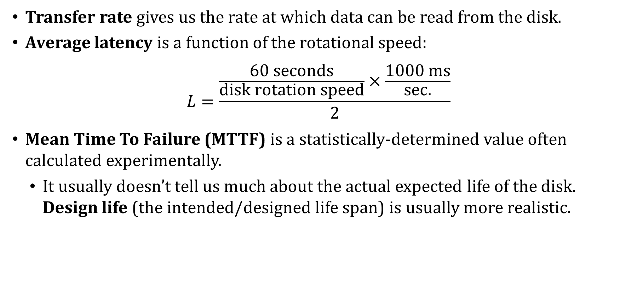
Magnetic Disk Technology
Transfer rate gives us the rate at which data can be read from the disk.
Average latency is a function of the rotational speed:
$$L=\frac{\frac{60 seconds}{disk rotation speed}×\frac{1000 ms}{sec.}}{2}$$
Mean Time To Failure (MTTF) is a statistically-determined value often calculated experimentally.
It usually doesn’t tell us much about the actual expected life of the disk. Design life (the intended/designed life span) is usually more realistic.

Slide 59
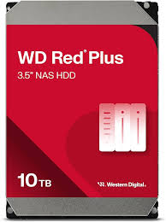
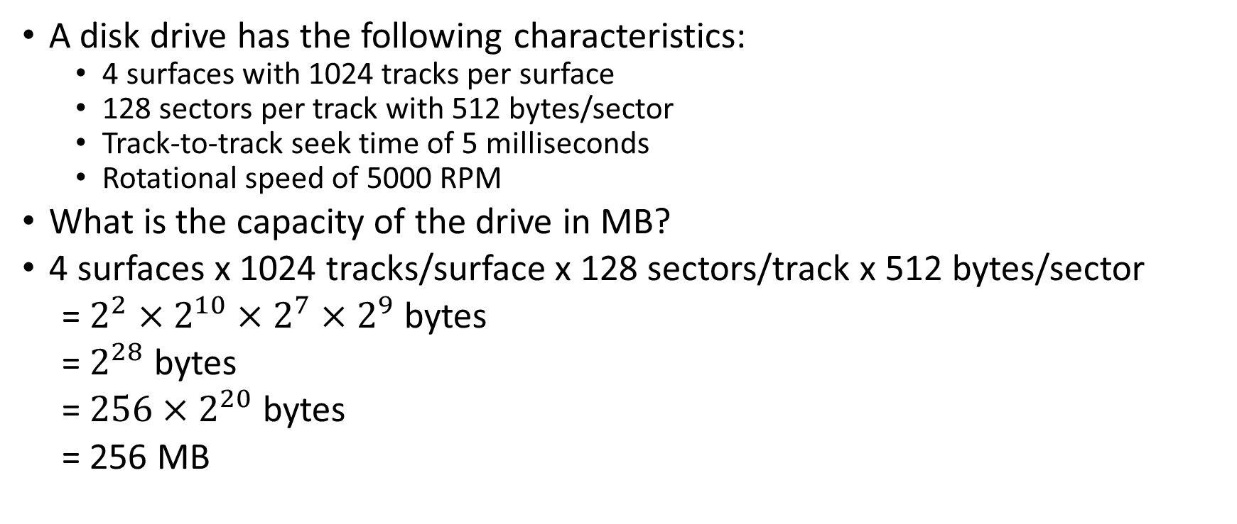
Magnetic Disks: Example #1
A disk drive has the following characteristics:
4 surfaces with 1024 tracks per surface
128 sectors per track with 512 bytes/sector
Track-to-track seek time of 5 milliseconds
Rotational speed of 5000 RPM
What is the capacity of the drive in MB?
4 surfaces x 1024 tracks/surface x 128 sectors/track x 512 bytes/sector
= $2^{2}×2^{10}×2^{7}×2^{9}$ bytes
= $2^{28}$ bytes
= $256×2^{20}$ bytes
= 256 MB
Real-life example:
Surfaces: 8
Tracks per surface: 500,000
Average sectors per track: 550
Bytes per sector: 4096
Total capacity ≈ 8 × 500,000 × 550 × 4096 bytes ≈ 9 TB

